Slide 1
SALES PREDICTION REPORT
9/1/2019

Slide 2
SUMMARY
Correlation between features
Linear Regression Model
Classifiers Modeling + Results:
SVM
Random Forest
Gradient Boosting
Selected Classifier
New Product Predictions
Chart: Impact of Customer and Service Reviews
Questions

Slide 3
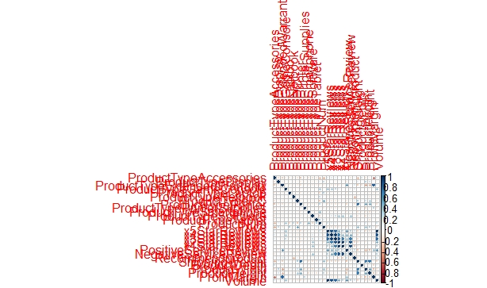
CORRELATION

Slide 4
LINEAR REGRESSION
Call:
lm(formula = Volume ~ ., data = trainSet)
Residuals:
Min 1Q Median 3Q Max
-8.214e-13 -1.075e-13 9.540e-15 8.796e-14 8.214e-13
Coefficients: (1 not defined because of singularities)
Estimate Std. Error t value Pr(>|t|)
(Intercept) -2.875e-13 9.988e-13 -2.880e-01 0.7755
ProductTypeAccessories 1.616e-13 4.233e-13 3.820e-01 0.7054
ProductTypeDisplay -9.237e-14 3.667e-13 -2.520e-01 0.8029
ProductTypeExtendedWarranty -9.723e-13 9.137e-13 -1.064e+00 0.2960
ProductTypeGameConsole -4.794e-13 4.793e-13 -1.000e+00 0.3255
ProductTypeLaptop 1.105e-13 4.509e-13 2.450e-01 0.8081
ProductTypeNetbook -4.510e-13 4.198e-13 -1.074e+00 0.2916
ProductTypePC 1.806e-13 4.925e-13 3.670e-01 0.7165
ProductTypePrinter -3.266e-13 4.820e-13 -6.780e-01 0.5035
ProductTypePrinterSupplies -6.518e-13 7.122e-13 -9.150e-01 0.3676
ProductTypeSmartphone -1.620e-13 3.207e-13 -5.050e-01 0.6172
ProductTypeSoftware -8.286e-13 7.266e-13 -1.140e+00 0.2635
ProductTypeTablet NA NA NA NA
ProductNum 4.617e-15 4.587e-15 1.006e+00 0.3225
Price -1.944e-16 3.791e-16 -5.130e-01 0.6119
x5StarReviews 4.000e+00 5.377e-16 7.439e+15 <2e-16 ***
x4StarReviews -6.718e-16 5.658e-15 -1.190e-01 0.9063
x3StarReviews -4.549e-16 1.694e-14 -2.700e-02 0.9788
x2StarReviews -8.031e-15 1.410e-14 -5.690e-01 0.5734
x1StarReviews 1.233e-15 3.311e-15 3.720e-01 0.7124
PositiveServiceReview 1.100e-15 1.096e-15 1.004e+00 0.3238
NegativeServiceReview 1.756e-14 2.797e-14 6.280e-01 0.5350
Recommendproduct -8.507e-13 3.754e-13 -2.266e+00 0.0311 *
ShippingWeight 8.436e-15 1.533e-14 5.500e-01 0.5864
ProductDepth 5.511e-16 3.997e-15 1.380e-01 0.8913
ProductWidth -1.903e-14 1.778e-14 -1.070e+00 0.2934
ProductHeight 7.600e-15 1.273e-14 5.970e-01 0.5551
ProfitMargin 2.179e-12 2.779e-12 7.840e-01 0.4393
---
Signif. codes: 0 ‘***’ 0.001 ‘**’ 0.01 ‘*’ 0.05 ‘.’ 0.1 ‘ ’ 1
Residual standard error: 3.241e-13 on 29 degrees of freedom
Multiple R-squared: 1, Adjusted R-squared: 1
F-statistic: 6.213e+31 on 26 and 29 DF, p-value: < 2.2e-16

Slide 5
SUPPORT VECTOR MACHINE (SVM)
Support Vector Machines with Linear Kernel
61 samples
27 predictors
Pre-processing: centered (27), scaled (27)
Resampling: Cross-Validated (10 fold, repeated 1 times)
Summary of sample sizes: 55, 56, 56, 54, 54, 54, ...
Resampling results:
RMSE Rsquared MAE
658.8332 0.9063066 371.8078
Tuning parameter 'C' was held constant at a value of 1
Notes:
model_svm <- svm(Volume ~ . , trainSet)
svmodel <- train(Volume ~., data = trainSet, method = "svmLinear", trControl=trctrl, preProcess = c("center", "scale"), tuneLength = 10)

Slide 6
SUPPORT VECTOR MACHINE (SVM)
Results
1 5 9 10 11 18 20
338.70637 689.92408 -73.13796 -246.75975 28.95906 1587.56638 140.83610
27 33 35 37 38 41 55
459.53661 -171.00390 1394.05922 1396.94786 1400.07382 1439.72356 430.79053
56 68 76 77 80
467.39507 383.20518 325.86444 113.42647 1901.07951
Notes:
model_svm <- svm(Volume ~ . , trainSet)

Slide 7
RANDOM FOREST
Random Forest
61 samples
27 predictors
No pre-processing
Resampling: Cross-Validated (10 fold, repeated 1 times)
Summary of sample sizes: 54, 56, 55, 54, 55, 56, ...
Resampling results across tuning parameters:
mtry RMSE Rsquared MAE
2 762.8921 0.8930653 421.6653
27 664.2574 0.9638893 289.9537
RMSE was used to select the optimal model using the smallest value.
The final value used for the model was mtry = 27.
Random Forest
61 samples
27 predictors
No pre-processing
Resampling: Cross-Validated (10 fold, repeated 1 times)
Summary of sample sizes: 55, 54, 55, 56, 54, 54, ...
Resampling results:
RMSE Rsquared MAE
741.8668 0.9516299 351.9384
Tuning parameter 'mtry' was held constant at a value of 5
Notes:
rfmodel <- train(Volume~., data = trainSet, method = "rf", trControl=fitControl, tuneLength = 1)
And
rfmodel <- train(Volume~., data = trainSet, method = "rf", trControl=fitControl, tuneLength = 2)

Slide 8
RANDOM FOREST
Results
1 5 9 10 11 18 20
21.67853 342.86960 54.20520 30.29600 100.29227 899.40053 89.81920
27 33 35 37 38 41 55
24.16920 18.40120 1236.44067 1234.99000 1235.29600 1235.76000 654.22720
56 68 76 77 80
365.04467 27.97947 247.14213 144.06173 2599.85160
Notes:
rfmodel <- train(Volume~., data = trainSet, method = "rf", trControl=fitControl, tuneLength = 1)
And
rfmodel <- train(Volume~., data = trainSet, method = "rf", trControl=fitControl, tuneLength = 2)

Slide 9
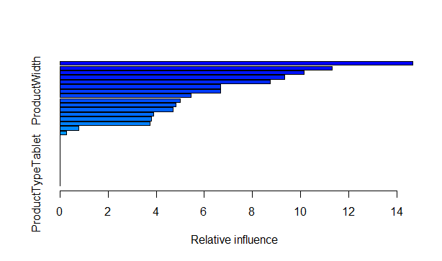
GRADIENT BOOSTING
gbm(formula = Volume ~ ., distribution = "gaussian", data = trainSet, n.trees = 10000, interaction.depth = 4, shrinkage = 0.01)
A gradient boosted model with gaussian loss function.
10000 iterations were performed.
There were 27 predictors of which 17 had non-zero influence.
Notes:
gbmodel <- gbm( formula = Volume ~ ., data=trainSet , distribution = "gaussian",n.trees = 1000, shrinkage = 0.01, interaction.depth = 4)

Slide 10
GRADIENT BOOSTING
Results
[1] -196.60042 635.06233 -716.85660 339.02571 97.37241 968.78705 -548.15535
[8] -257.08361 -94.81231 1531.60048 1531.28587 1529.85190 1541.94894 1003.76540
[15] 224.55984 197.96326 365.82491 352.51917 2267.90463
Notes:
gbmodel <- gbm( formula = Volume ~ ., data=trainSet , distribution = "gaussian",n.trees = 10000, shrinkage = 0.01, interaction.depth = 4)
gbpred <- predict(gbmodel, newdata = testSet, n.trees = gbmodel$n.trees)

Slide 11
SELECTED MODEL IS : Random Forest
After reviewing my models results, the one that I have selected and has performed best without overfitting was the random Forest because:
Predicted values were not negative
RMSE = 664.2574
R-Squared = 0.9638893

Slide 12
New Product Predictions
ProductType | predictionType | ProfitabilityType | BestSellersRankType
PC | 638 | 473974 | 2988
Laptop | 341 | 411973 | 7377
Netbook | 1407 | 482734 | 13671
Smartphone | 2167 | 364450 | 69024

Slide 13
Impact of Customer and Service Reviews

Slide 14
QUESTIONS
Did you learn anything of potential business value from this analysis?
Yes, Customers and service reviews have an immense impact on the sales.
Was it straightforward to rerun your projections of sales volume using both models?
Yes.
What are the main lessons you've learned from this experience?
How to Apply a regression model on a data frame with nominal variable.
What recommendations would you give to the sales department regarding your findings relating to the different types of reviews?
Work more on the offers related to both types' PC and Laptops.

Slide 15
THANK YOU !

